Slide 1
Relationships between crime and income!
Team Members: Delayna Bradshaw, Kerry Kovacik, Michael Kung, Tito Odunsi
Notes:
Tito

Slide 2
Hypothesis!
There is an inverse relationship between income and crime in the city of Austin, Texas (lower income, higher crime & vice versa).
Notes:
Tito

Slide 3
Data Sources, Exploration and Analysis!
For crime data, Austintexas.gov (https://data.austintexas.gov/resource/mfej-x5pm.json)
For income data, Census (Census API)
*We used 2011 & 2016 because they were the widest range for income data available on the census API.
Notes:
Tito

Slide 4
Data exploration and clean up process!
For census data, we used an API key to pull 2011 & 2016 data by zip code.
For crime data, we filtered the CSV files to gather data for crimes that occurred in 2011 & 2016.
Since the census data contained all U.S. zip codes, we pulled the Austin zip codes from the crime data.
Then we used a for-loop to pull income data for Austin zip codes.
Merged the years (2011 and 2016) into the same data frame.
For crime, we also counted the crimes per zip codes.
Once we cleaned the data for crime and income in 2011 & 2016, we combined all of the information into one data frame.
Notes:
Tito

Slide 5
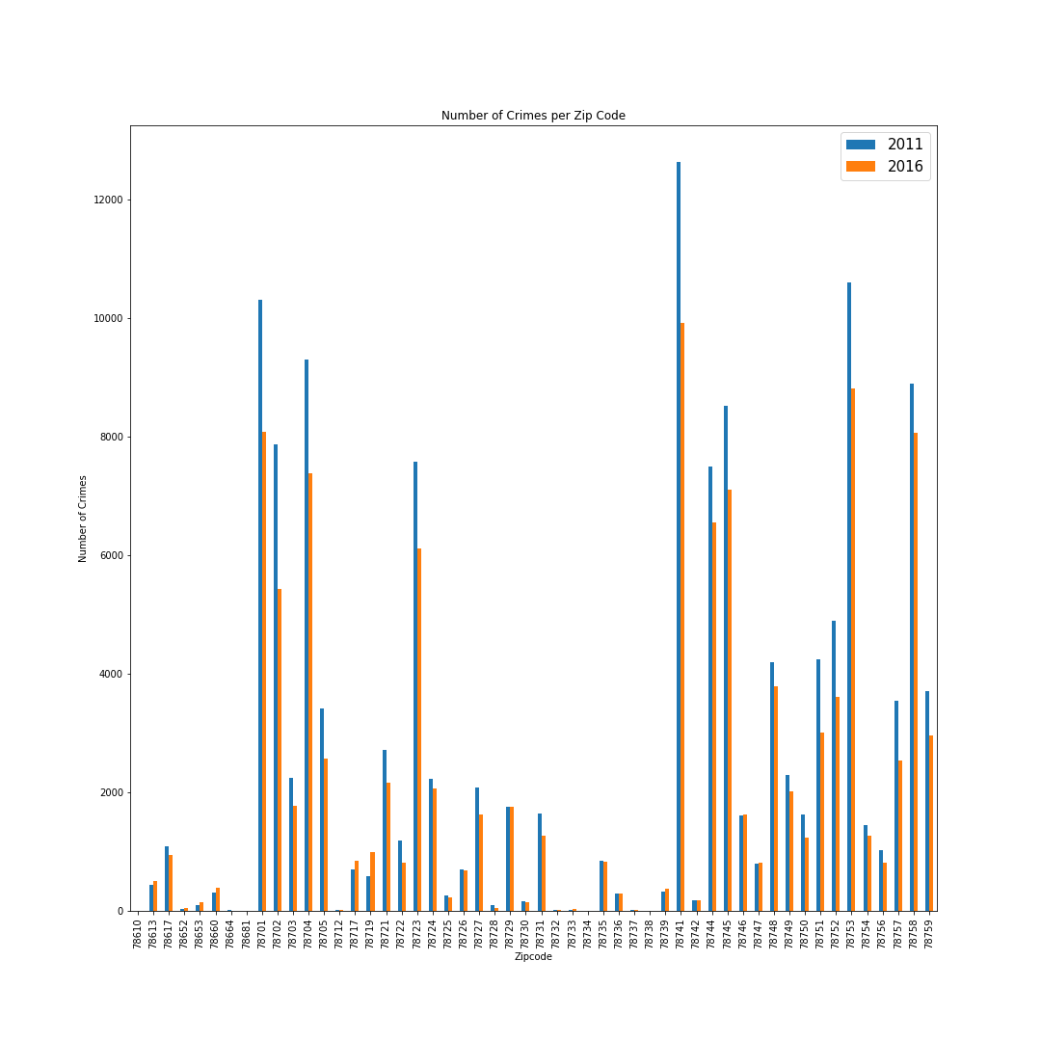
How have crime rates changed by zip code from 2011 to 2016?! All of Austin?!
Notes:
Kerry

Slide 6
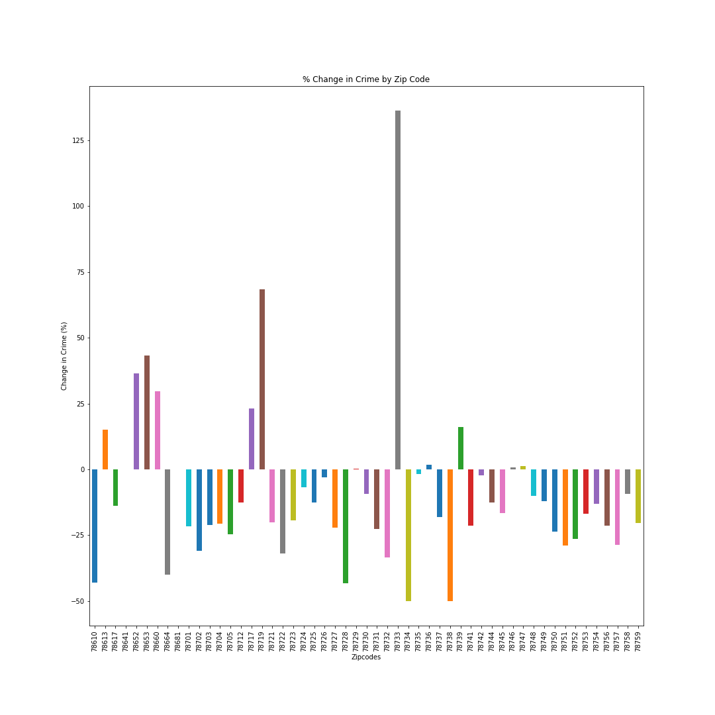
Notes:
Kerry

Slide 7
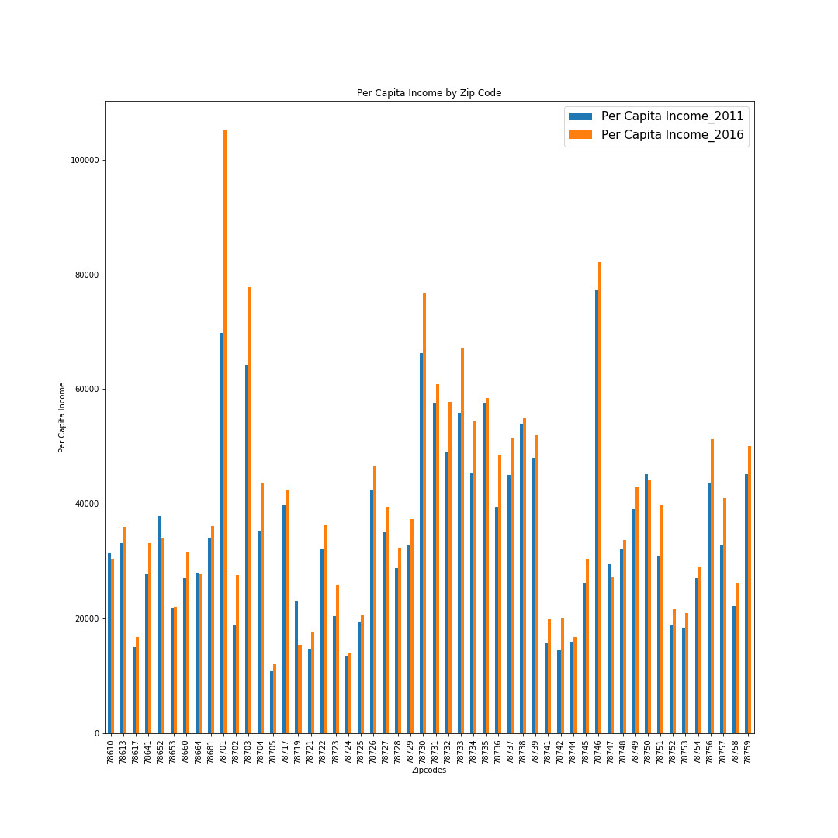
How have incomes changed by zip code from 2011 to 2016 (5 year look)?!
Notes:
Kerry

Slide 8
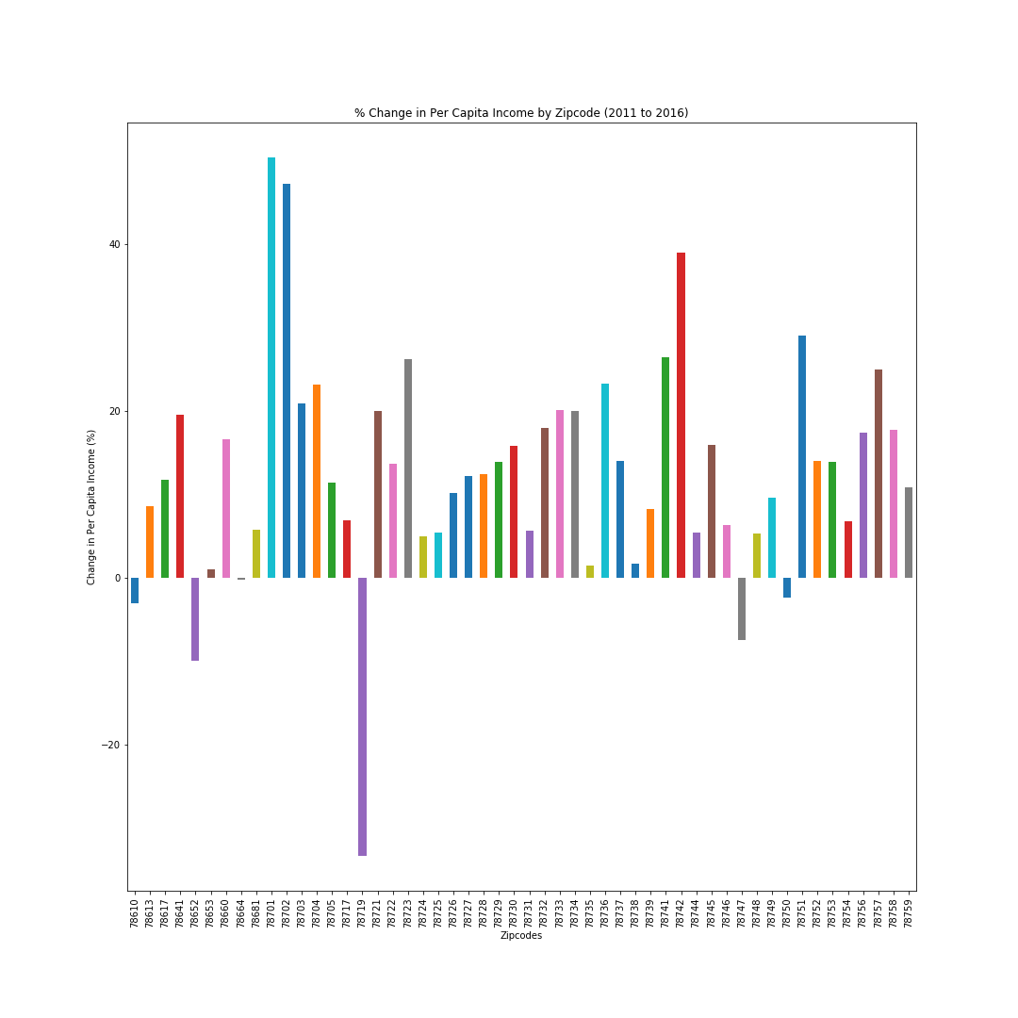
Notes:
Kerry

Slide 9
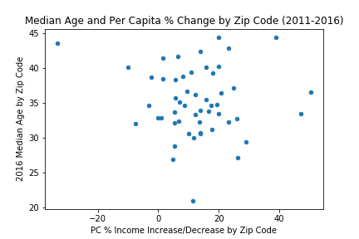
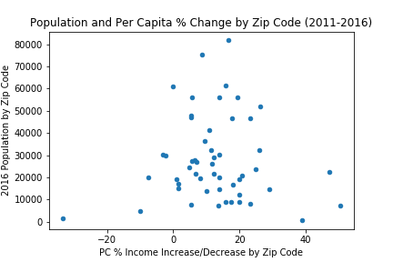
Does Age or population have an affect on income?! .
We utilized age and population data from the census api because we wanted to rule out the possibility of these variables affecting our hypothesis.
There does not appear to be a relationship between age or population, and percent change of per capita income from 2011 – 2016.
Notes:
Delayna

Slide 10
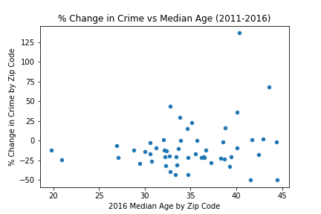
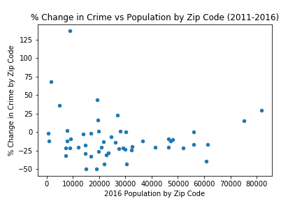
Does Age or population have an affect on crime?!
Crime went down across the board, for population or age and percent change in crime. There does not appear to be a correlation.
Notes:
Delayna

Slide 11
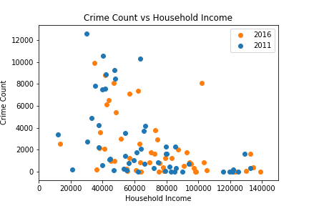
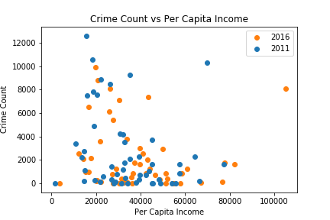
Is there a correlation between income and amount of crime?!
There seems to be a base amount of crime across incomes, but, when the crime rates exceed a count of 5,000-6,000, they are overwhelmingly in lower income areas.
Notes:
Michael

Slide 12
Conclusions!
For the vast majority of Austin zip codes, the income has increased from 2011-2016.
For the majority of the zip codes in all of Austin, crime rates decreased from 2011-2016.
There is no significant correlation between the age/population and income.
Neither age nor population have a significant effect on crime.
There is a certain degree of correlation between income and crime.
Notes:
Michael

Slide 13
Limitations
For future research, deeper investigation can be taken to research different types of crime in zip codes.
We may have received different results if we had a larger time frame to pull from.
Notes:
Michael

